Slide 1
Effectiveness of connected components labelling approach in noise reduction for image de-fencing
Aditi Awasthi
Deepthi Bhat
Medhini Oak
Kayarvizhy N
B.M.S. College Of Engineering

Slide 2
What is de-fencing?
What are its applications?

Slide 3
Foundational idea
Fence edges = semi-periodic signals in image
Can be segregated mathematically
Connected components labelling greatly improves quality of fence mask produced

Slide 4
Proposed Methodology

Slide 5
Obtaining raw fence mask
Manipulation in Frequency Domain
Quasi-periodic texture filtering
Multi-resolution Processing

Slide 6
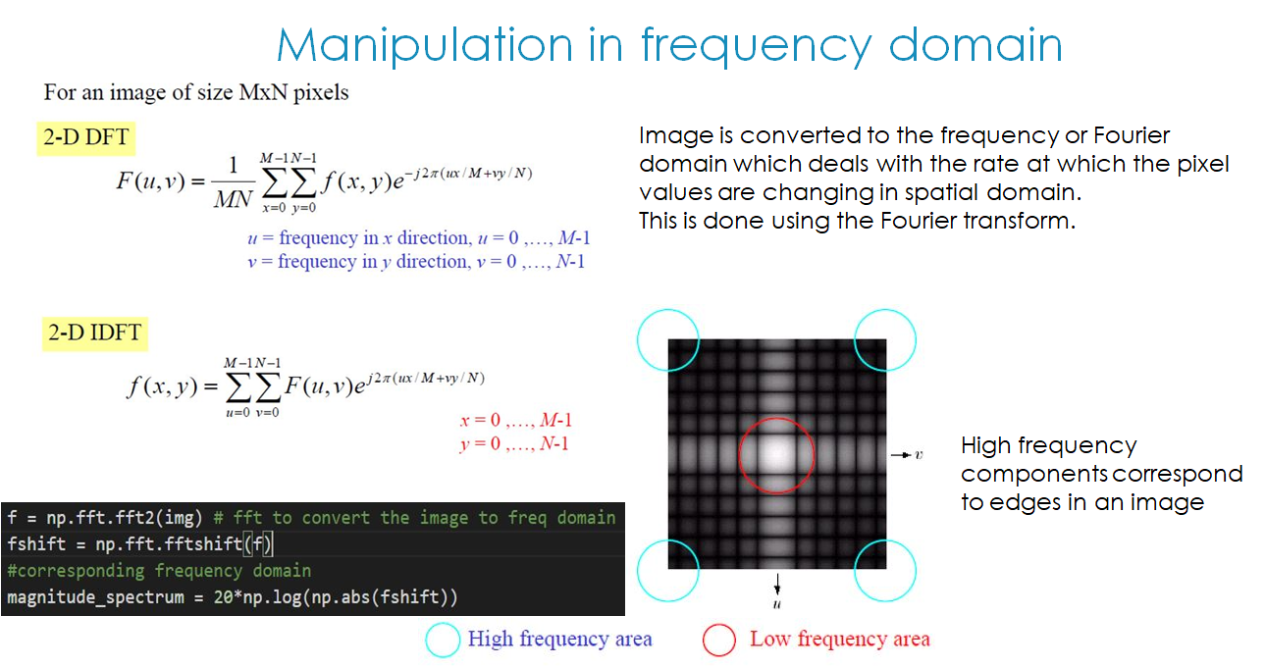

Slide 7
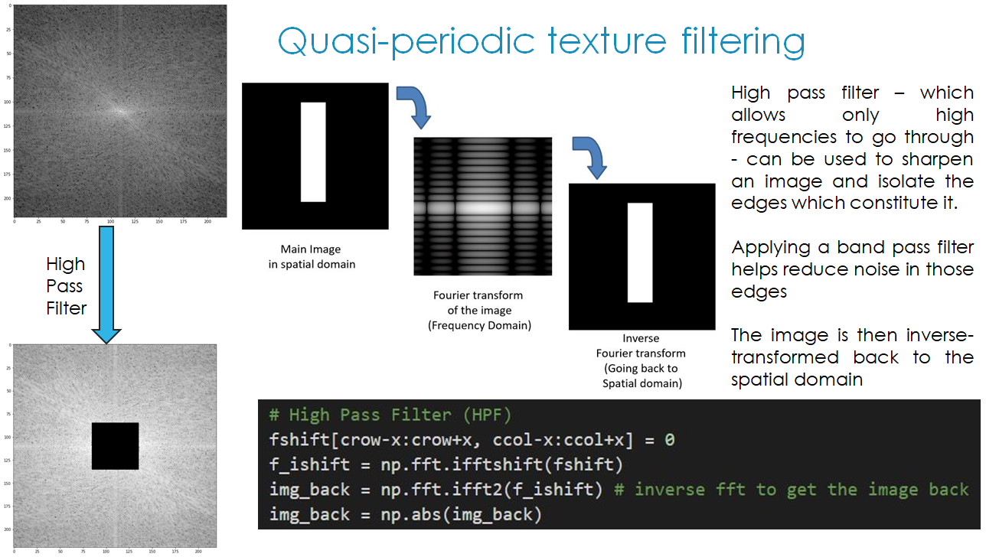

Slide 8
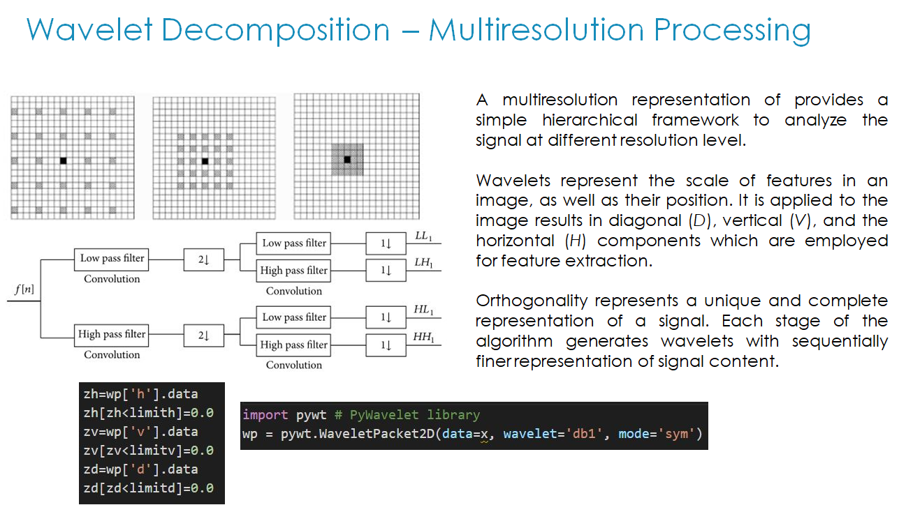

Slide 9
Noise Removal
Connected Component Labelling
Morphological closing

Slide 10
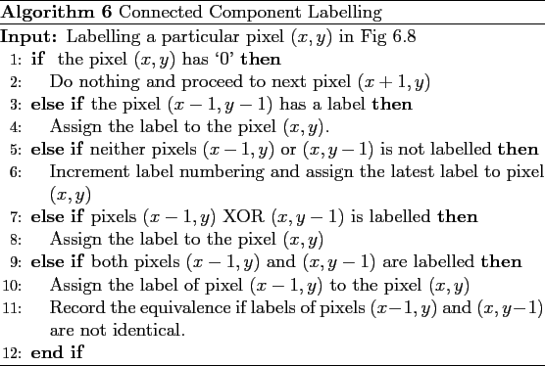
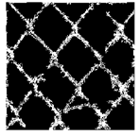
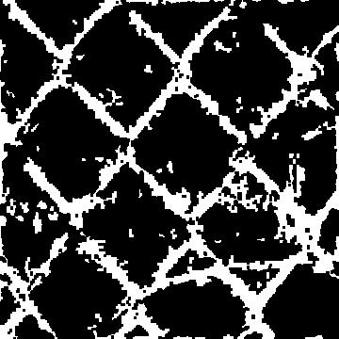
Connected Component Labelling
Connected components labeling scans an image and groups its pixels into components based on pixel connectivity, i.e. all pixels in a connected component share similar pixel intensity values and are in some way connected with each other. Once all groups have been determined, each pixel is labeled according to the component it was assigned to.

Slide 11
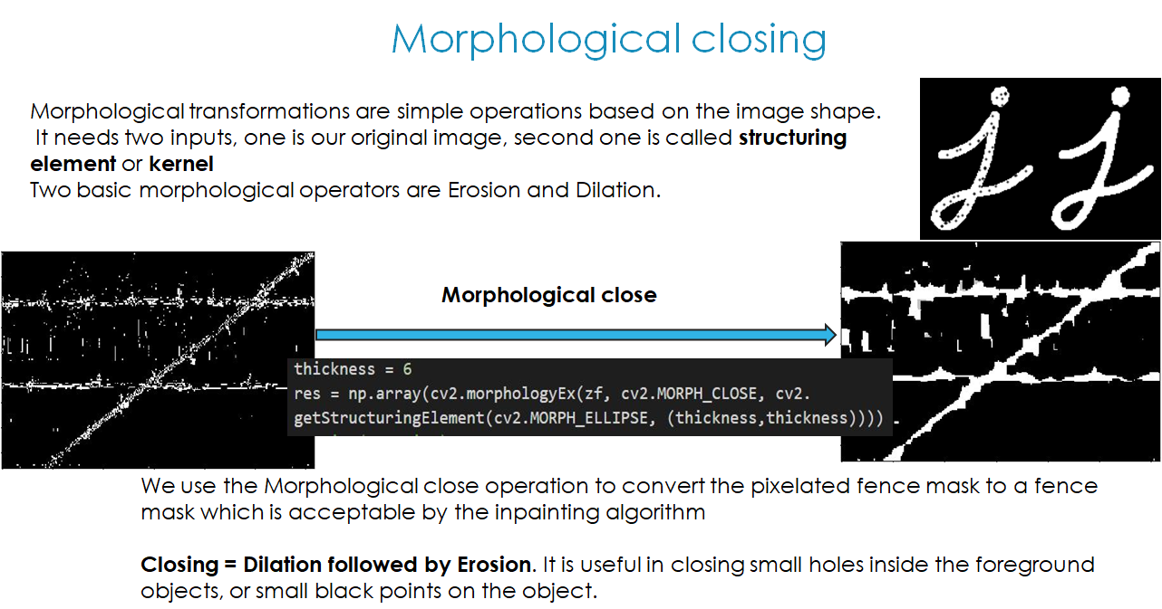

Slide 12
Experimental results

Slide 13
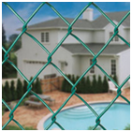
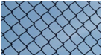
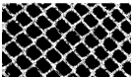
Input Image | Resultant fence mask by connected components technique

Slide 14
Why is this a non-trivial task?

Slide 15
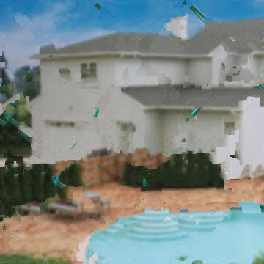
Results after Inpainting

Slide 16
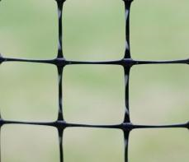
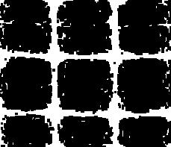

Results after Inpainting

Slide 17
Future Work
Frame-by-frame detection of fences in videos containing occlusions can also be attempted
Improvement on the accuracy of the fence mask, especially when dealing with low resolution images

Slide 18
Thank you!

Slide 19
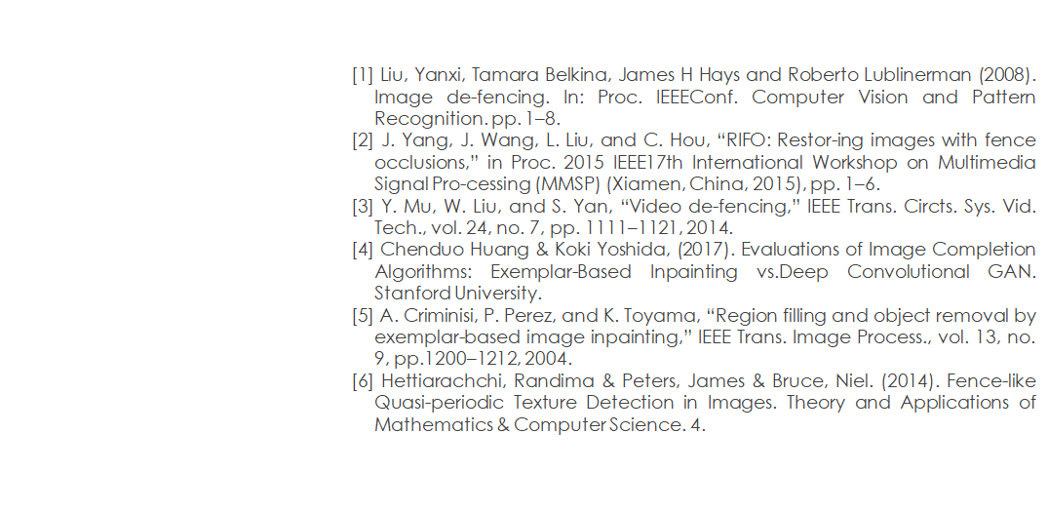
References

